Slide 1


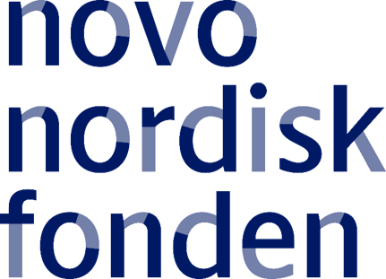
py for metabolomics
Eftychia Eva Kontou, Axel Walter
Röst, H.L., Sachsenberg, T., Aiche, S., Bielow, C., Weisser, H., Aicheler, F., Andreotti, S., Ehrlich, H.-C., Gutenbrunner, P., Kenar, E., Liang, X., Nahnsen, S., Nilse, L., Pfeuffer, J., Rosenberger, G., Rurik, M., Schmitt, U., Veit, J., Walzer, M., Wojnar, D., Wolski, W.E.,
Schilling, O., Choudhary, J.S., Malmström, L., Aebersold, R., Reinert, K., Kohlbacher, O. OpenMS: A flexible open-source software platform for mass spectrometry data analysis. Nature Methods, vol. 13, 2016. doi:10.1038/nmeth.3959

Slide 2
Computational Metabolomics/Proteomics
Hundreds of experimental methods and protocols
Many computational methods for
Identification
Quantification
Statistical analysis
often tailored to experimental method Goal: Extraction of maximum biological knowledge
2

Slide 3
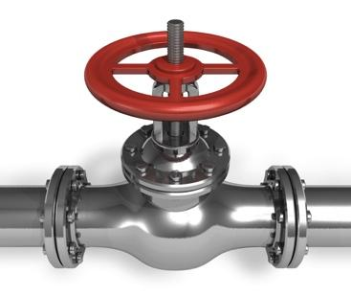

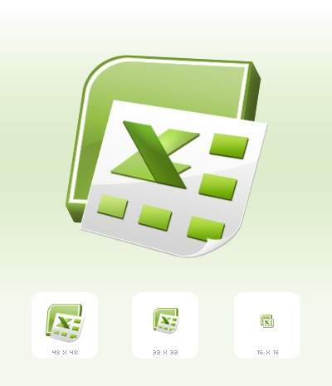

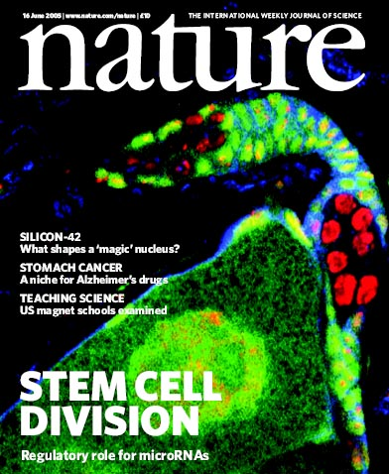
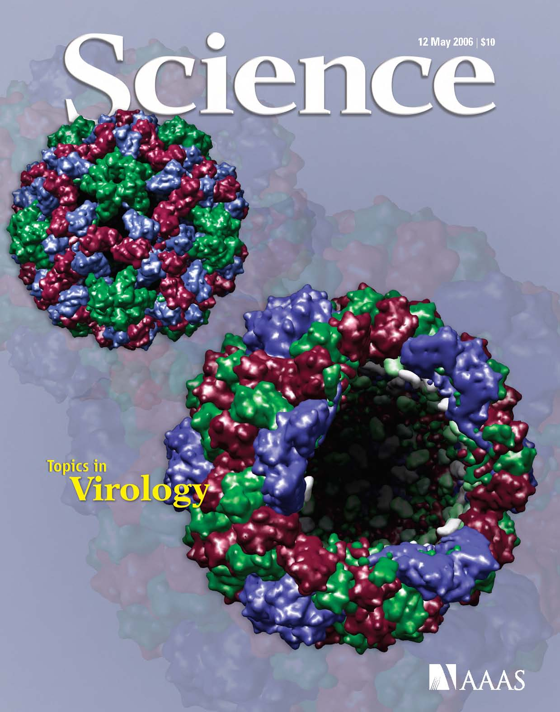
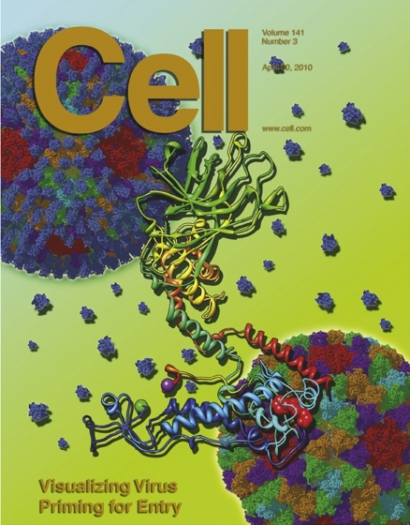
Bioinformatics – The Holy Grail
3
Notes:
direct publishing after straightforward software analysis
“One-Tool-Solution” for every type of experiment
the workflow should replace most of the informatics part of the methods section (a zip in addition to the “Excel” results)

Slide 4

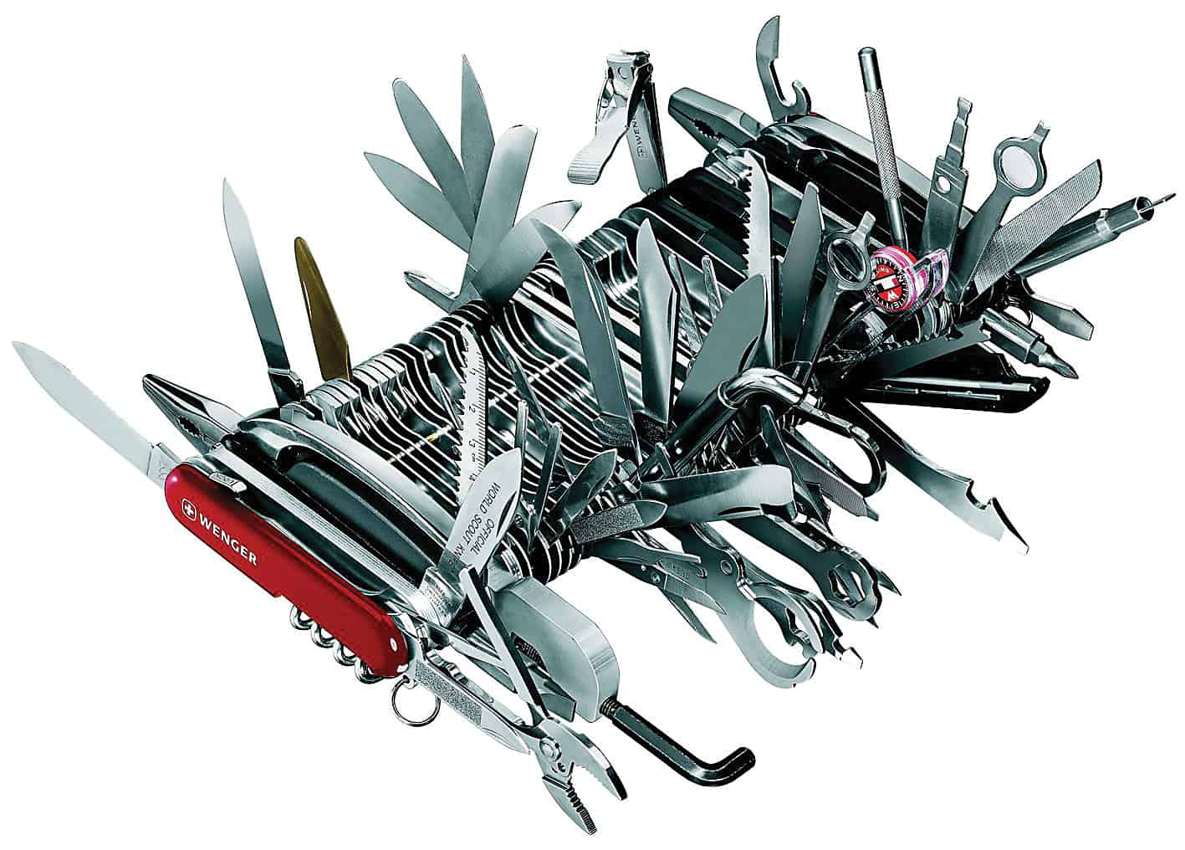
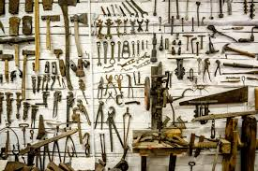
Mass Spectrometry Workflows
Are diverse:
Proteomics/metabolomics/interactomics, …
Separation methods/Acquisition
with/without label
Experimental designs
→ A single workflow or tool is not enough
Solution: A set of tools that can be combined to highly flexible workflows
4

Slide 5
What is OpenMS?

Slide 6
What is OpenMS?
OpenMS is:
Computational library, tools, and workflows for the analysis of mass spectrometry data
Open-source and free of charge
Vendor-independent: Supports vendor-formats through conversion with proteowizard library
Standards: Supports all major file formats (PSI)
6

Slide 7
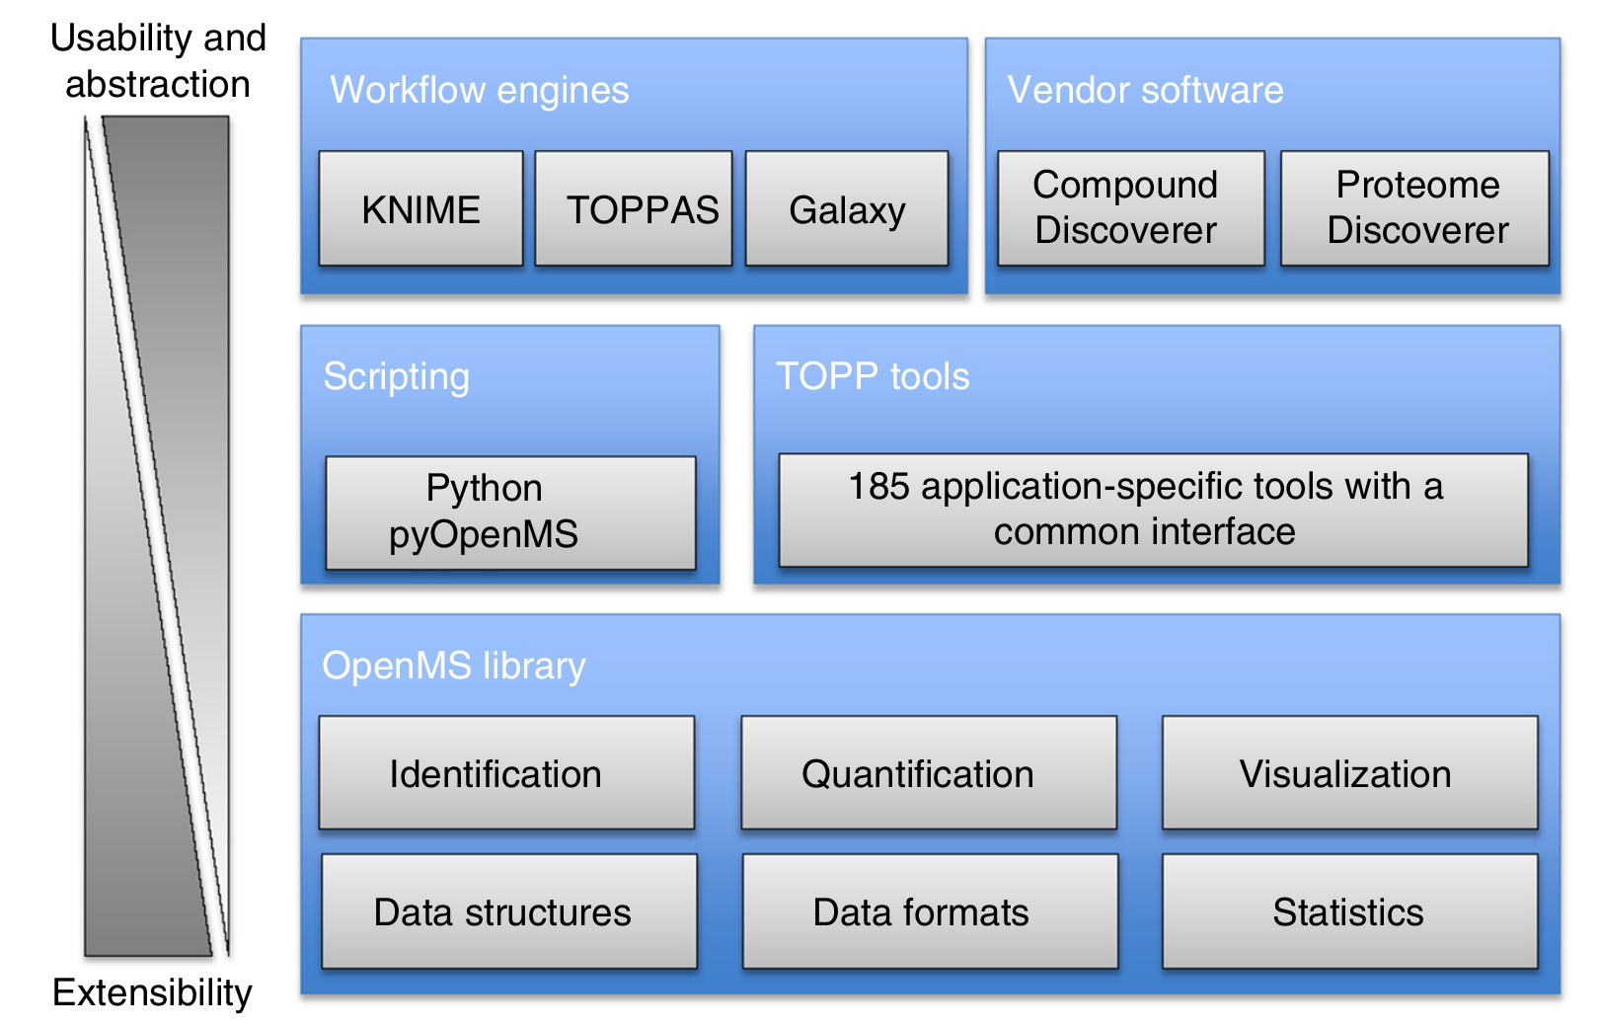
The OpenMS framework
nextflow
7
Notes:
To understand OpenMS we need to understand

Slide 8
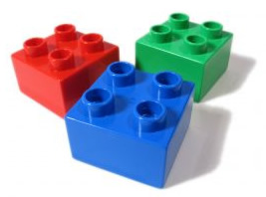
OpenMS Tools
TOPP tools – The OpenMS PiPeline tools
> 180 Building blocks: One application for each analysis step
All applications share identical user interfaces
Exchange data in PSI standard formats
→ Easily integrated in various workflow systems
Support for other tools (e.g., SIRIUS, GNPS...)
8

Slide 9



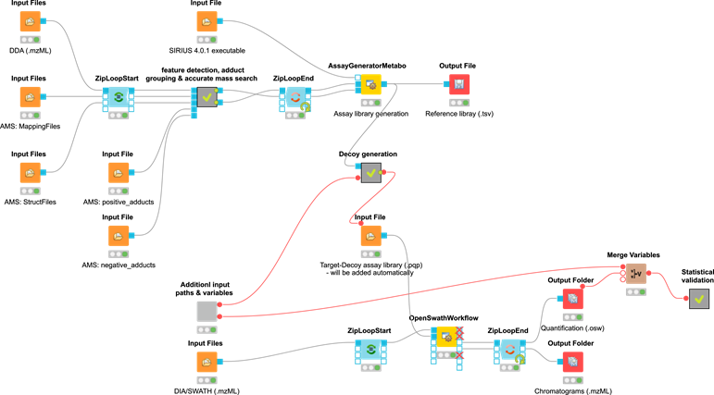
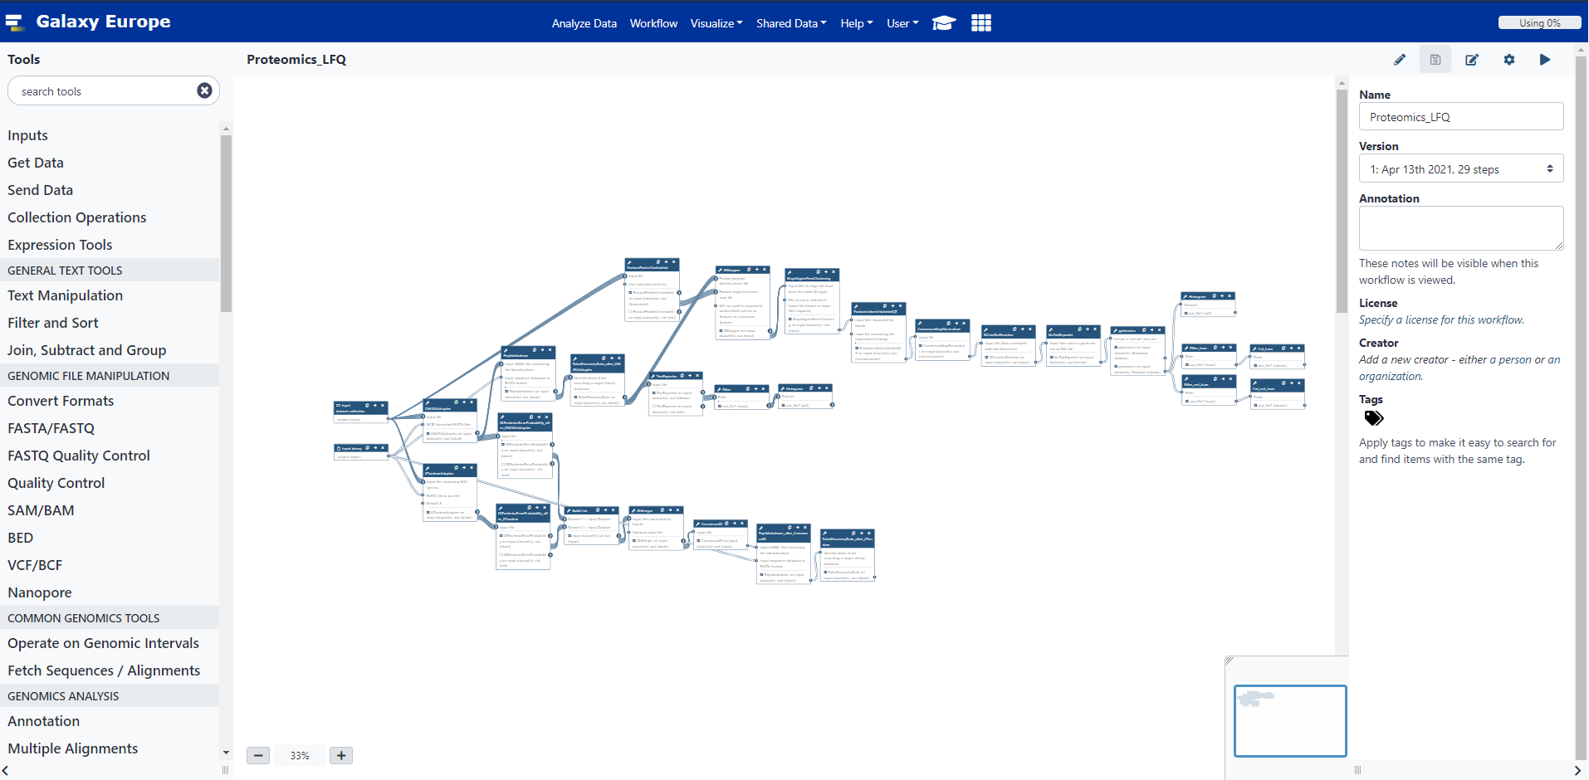
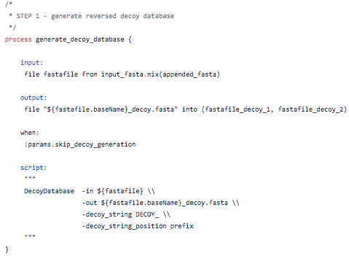
OpenMS workflows
Chaining of tools to build workflows Facilitate reproducible and reusable research
Different workflow systems:
9
Matthias Bernt, UFZ Leipzig
Notes:
Many workflow systems exist with different characteristics:
Standalone, server-based or both
Different levels of visualization of the workflows (from scripts only to visually construct- and configurable with interactive outputs)
Different executors for various compute environments (local, container, cloud, HPC scheduler)
Workflow execution only vs. full integration platform
Galaxy Great for:
Integration created by Matthias Bernt, UFZ Leipzig
Stable workflows that only use tools of an OpenMS release (current 2.6.0)
Promoting tools without having users install OpenMS Why not try out our Protein-Protein cross-linking tool?
Getting compute infrastructure for free at https://usegalaxy.eu/

Slide 10


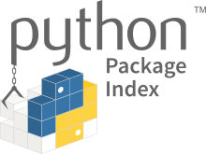

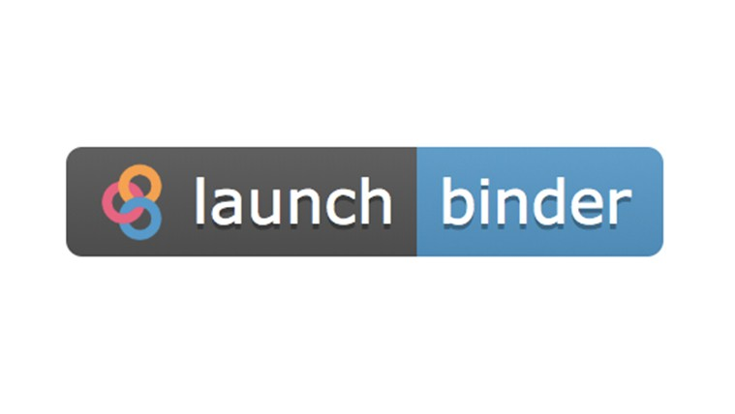
Scripting with OpenMS: pyOpenMS
OpenMS:
Compiled language (fast!)
Nontrivial to learn
Verbose syntax
Memory management
Dependencies (challenging for developers, easy for users)
pyOpenMS:
Wraps OpenMS
Interactive scripting
Easy to learn
Dependencies easy to install
10

Slide 11

Brief intermission..
https://github.com/axelwalter/pyopenms-workshop
Click on the

Slide 12
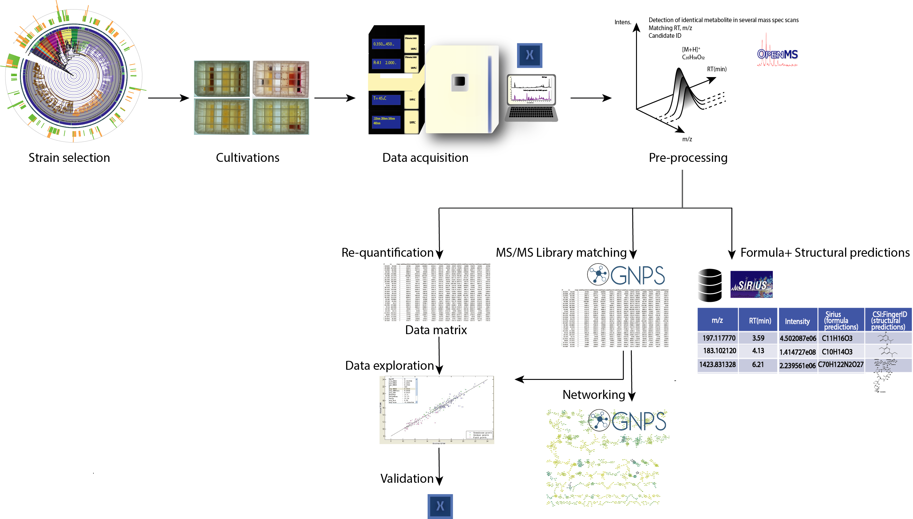


Metabolomics for Specialized Metabolites, Ph.D. (Efi)
Notes:
1250 raw data

Slide 13

pyOpenMS
UMETAFlow
Röst, H.L., Sachsenberg, T., Aiche, S., Bielow, C., Weisser, H., Aicheler, F., Andreotti, S., Ehrlich, H.-C., Gutenbrunner, P., Kenar, E., Liang, X., Nahnsen, S., Nilse, L., Pfeuffer, J., Rosenberger, G., Rurik, M., Schmitt, U., Veit, J., Walzer, M., Wojnar, D., Wolski, W.E.,Schilling, O., Choudhary, J.S., Malmström, L., Aebersold, R., Reinert, K., Kohlbacher, O. OpenMS: A flexible open-source software platform for mass spectrometry data analysis. Nature Methods, vol. 13, 2016. doi:10.1038/nmeth.3959
Kai Dührkop, Markus Fleischauer, Marcus Ludwig, Alexander A. Aksenov, Alexey V. Melnik, Marvin Meusel, Pieter C. Dorrestein, Juho Rousu, and Sebastian Böcker, SIRIUS 4: Turning tandem mass spectra into metabolite structure information. Nature Methods 16, 299–302, 2019.
Nothias, L.-F., Petras, D., Schmid, R. et al. Feature-based molecular networking in the GNPS analysis environment. Nat. Methods 17, 905–908 (2020).
Notes:
PREPROCESSING step: a series of algorithms that convert your raw data to a table of metabolic features
SIRIUS+CSI:FingerID: formula and structural predictions.
GNPS FBMN and library matching
Re-quantification &data exploration

Slide 14
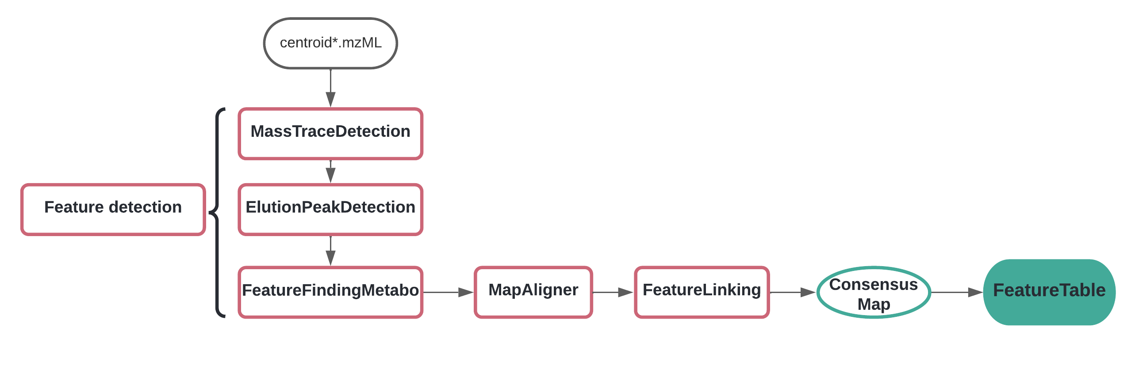
Pre-processing: From raw data to a table of metabolic features

Slide 15
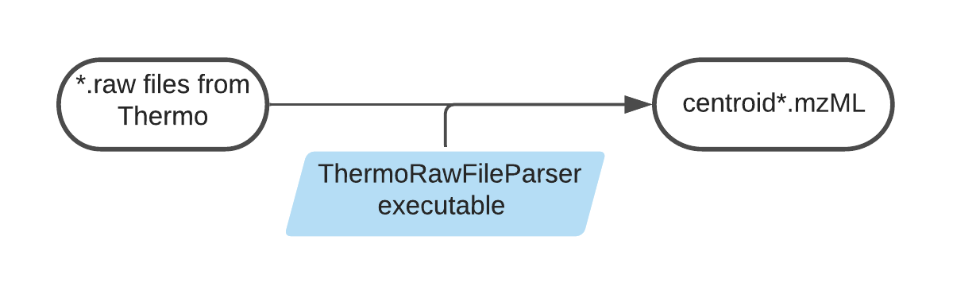
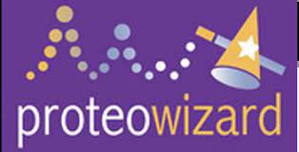
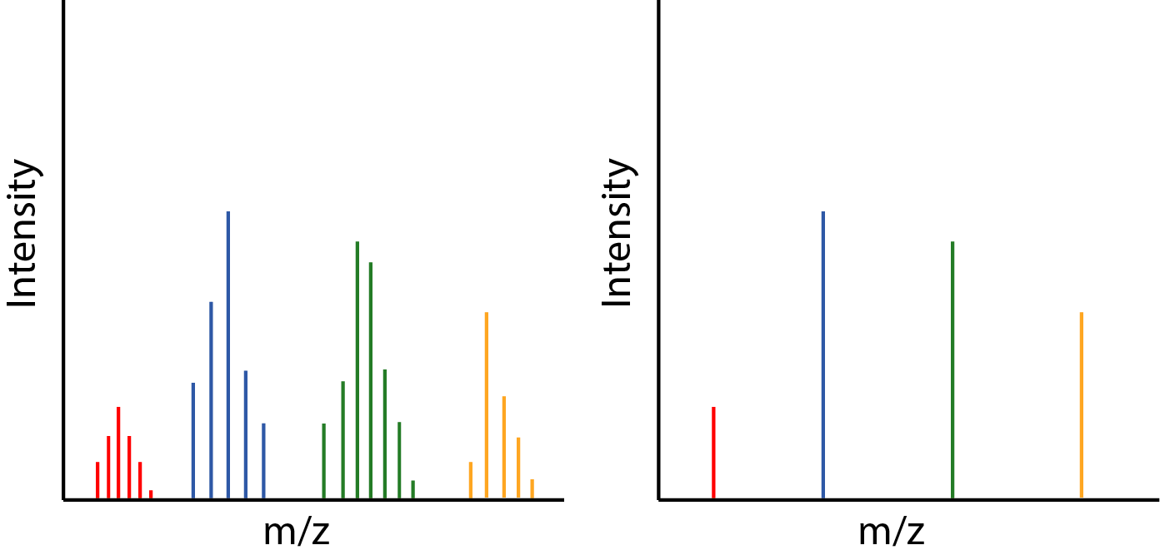
Data conversion
Vendor-format files to an open community-driven format
Profile data
Centroid data
Notes:
Different colors for different metabolites. The instrument will detect a compound m/z in a window of 10 ppm error approximately. It doesn’t always measure the same exact m/z (it shifts a bit) – so centroiding will only keep the local maximum of each range.

Slide 16
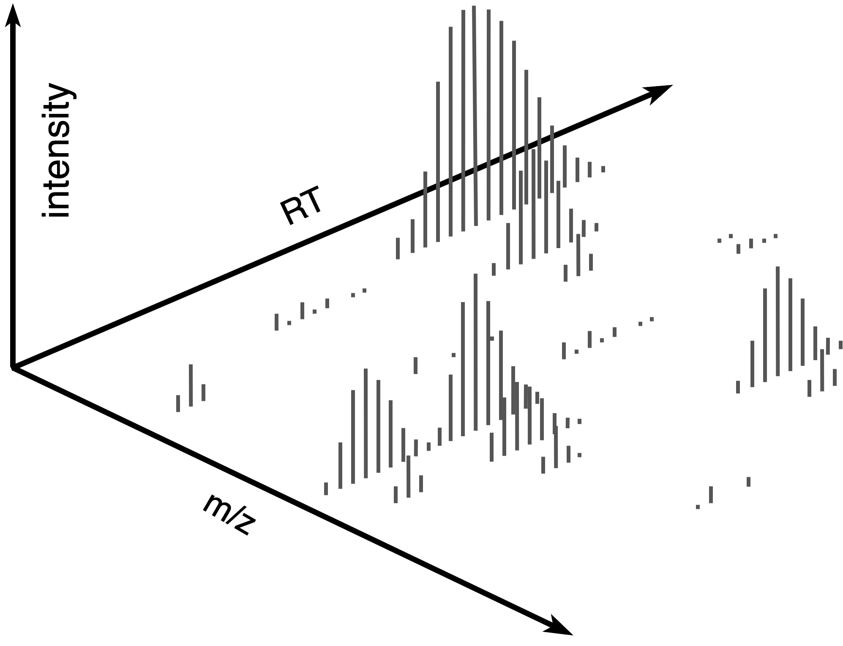
Feature detection (raw mzML)
Notes:
First step of preprocessing is feature detection

Slide 17
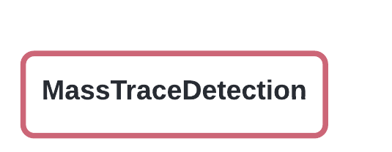
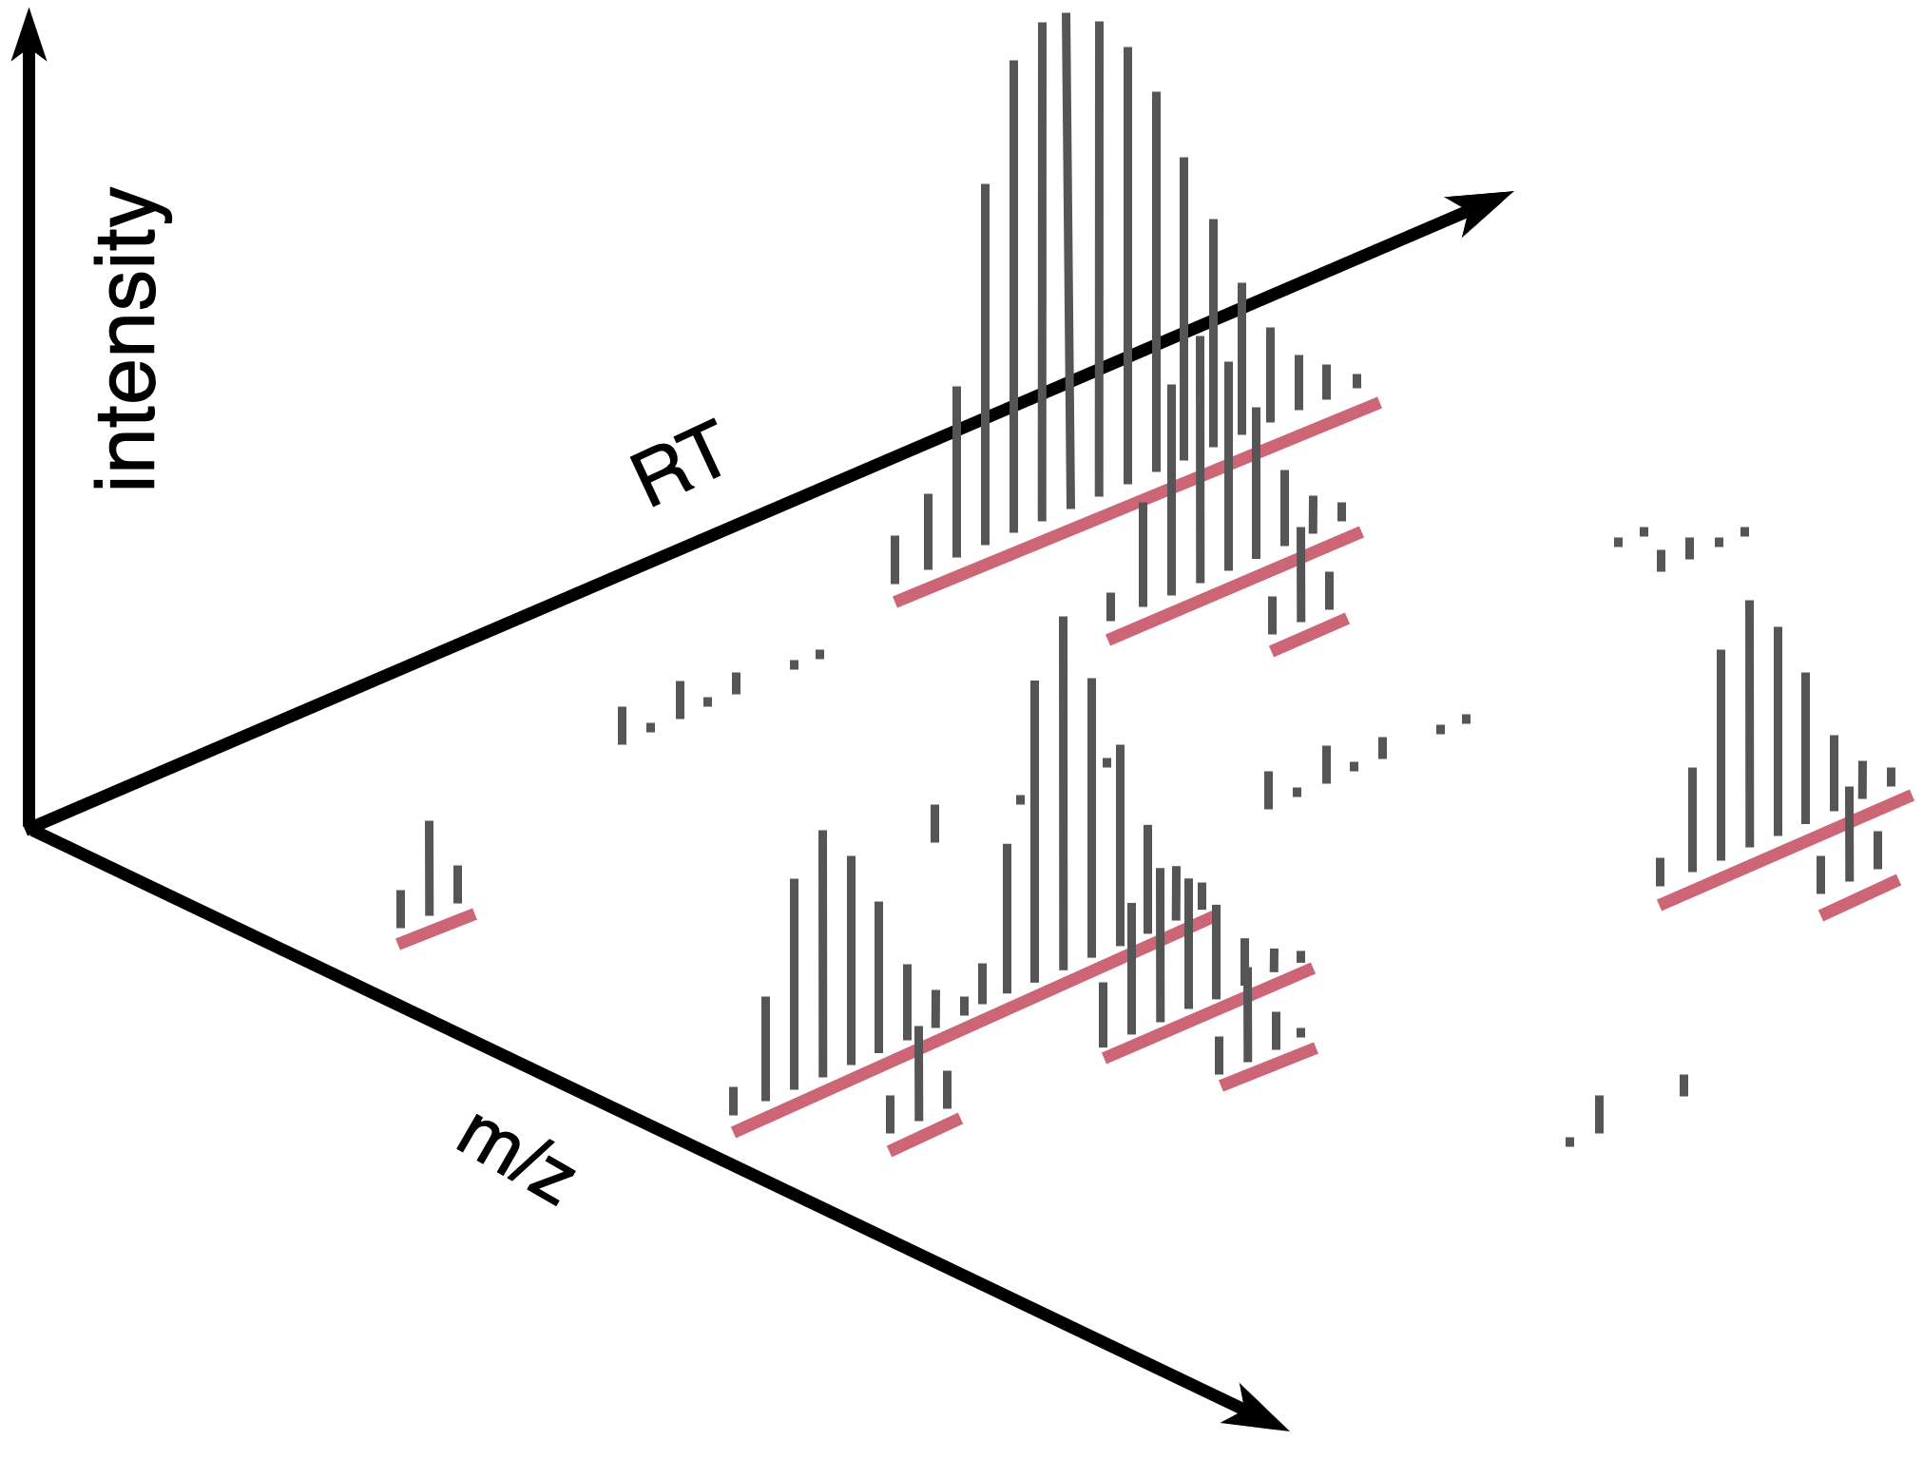
1. Mass trace detection
A mass trace extraction method that gathers peaks similar in m/z and moving along retention time.
Notes:
Only peaks that are above the noise threshold (user-defined) are taken into account. This saves computational resources and decreases the noise in the resulting output. Mass traces are extended in retention time. The extension phase ends when either the frequency of gathered peaks drops below a threshold.

Slide 18
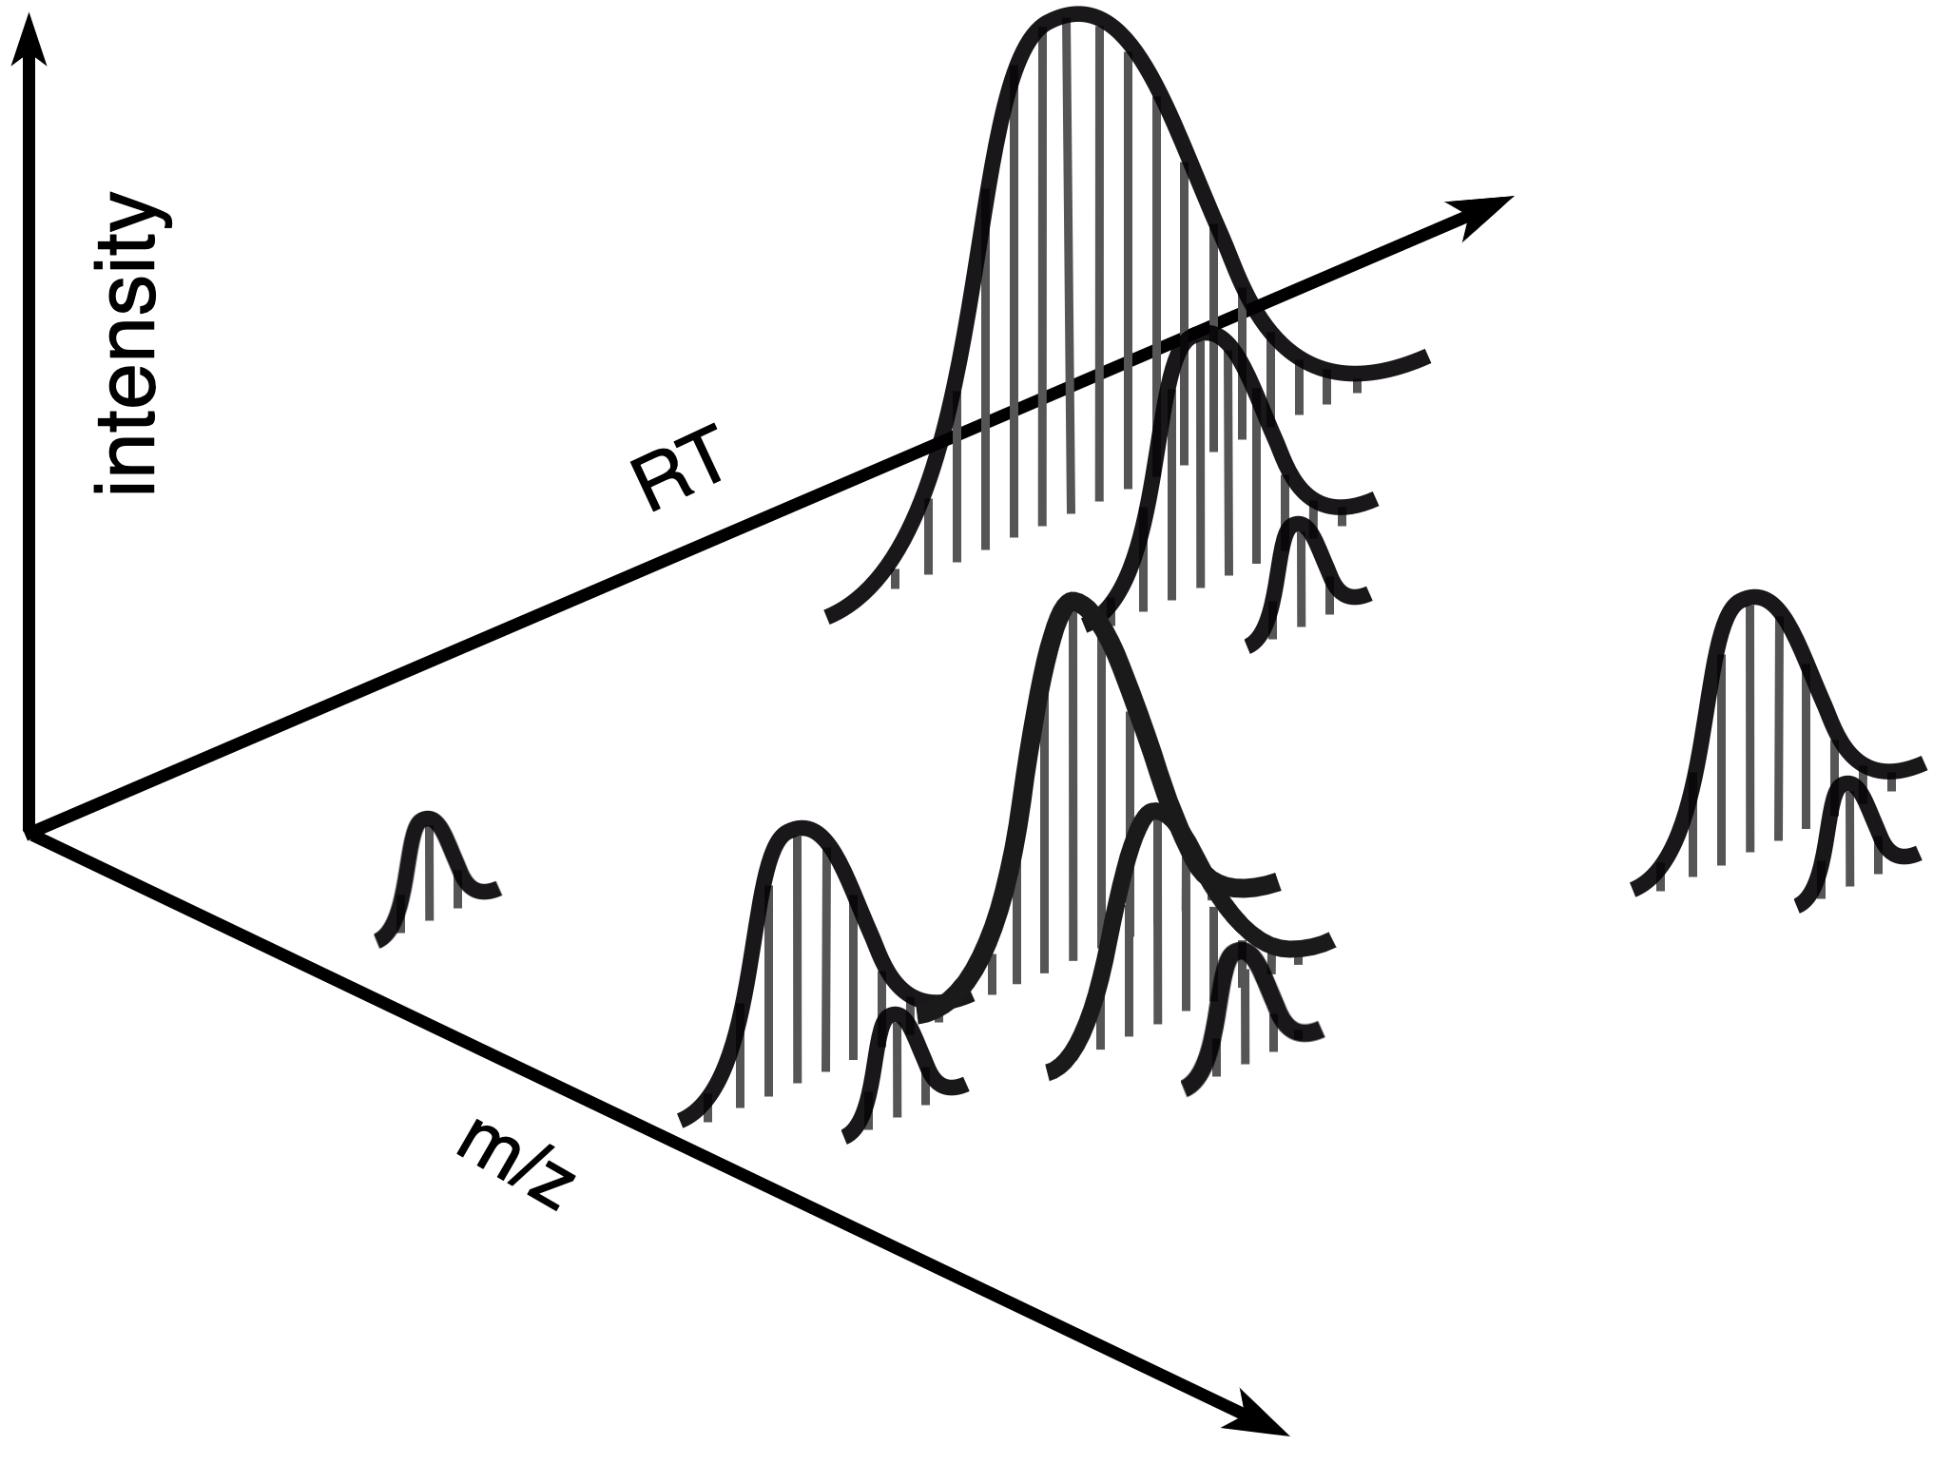
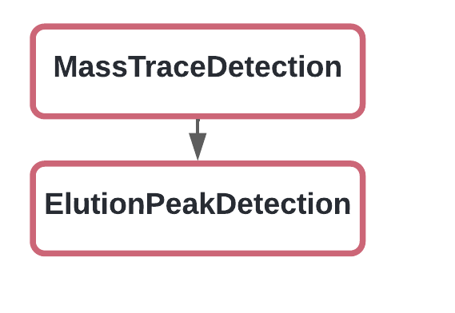
2. Elution peak detection
Extracts chromatographic peaks from a mass trace.
Notes:
Mass traces may consist of several consecutively (partly overlapping) eluting peaks. Especially in metabolomics, isomeric compounds with exactly the same mass but different retentional behaviour may still be contained in the same mass trace. This detects local minima/maxima in order to separate the chromatographic peaks from each other . This method in other words is "deconvolution”.

Slide 19
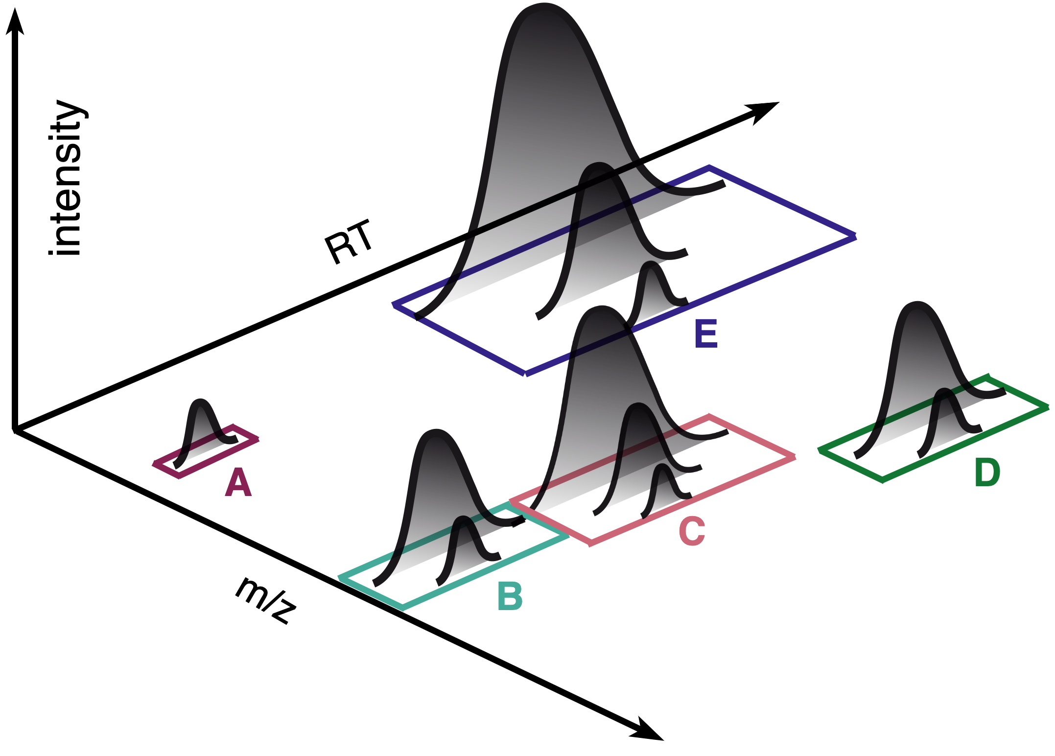
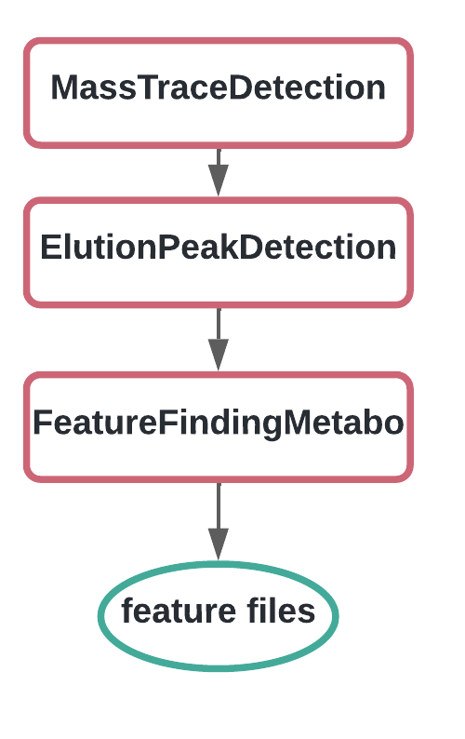
3. FeatureFinder
Assembles metabolite features from singleton mass traces.
Notes:
Monoisotopic mass traces are accompanied by satellite C13 peaks and thus may make the analysis more difficult. FeatureFinderMetabo fulfills a further data reduction step by assembling compatible mass traces to metabolite features (that is, all mass traces originating from one metabolite).

Slide 20
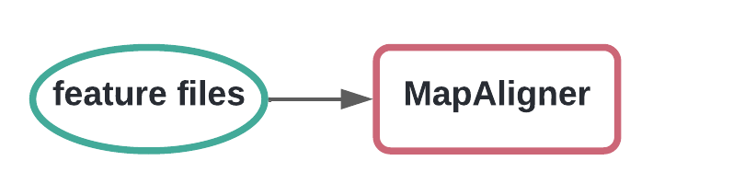
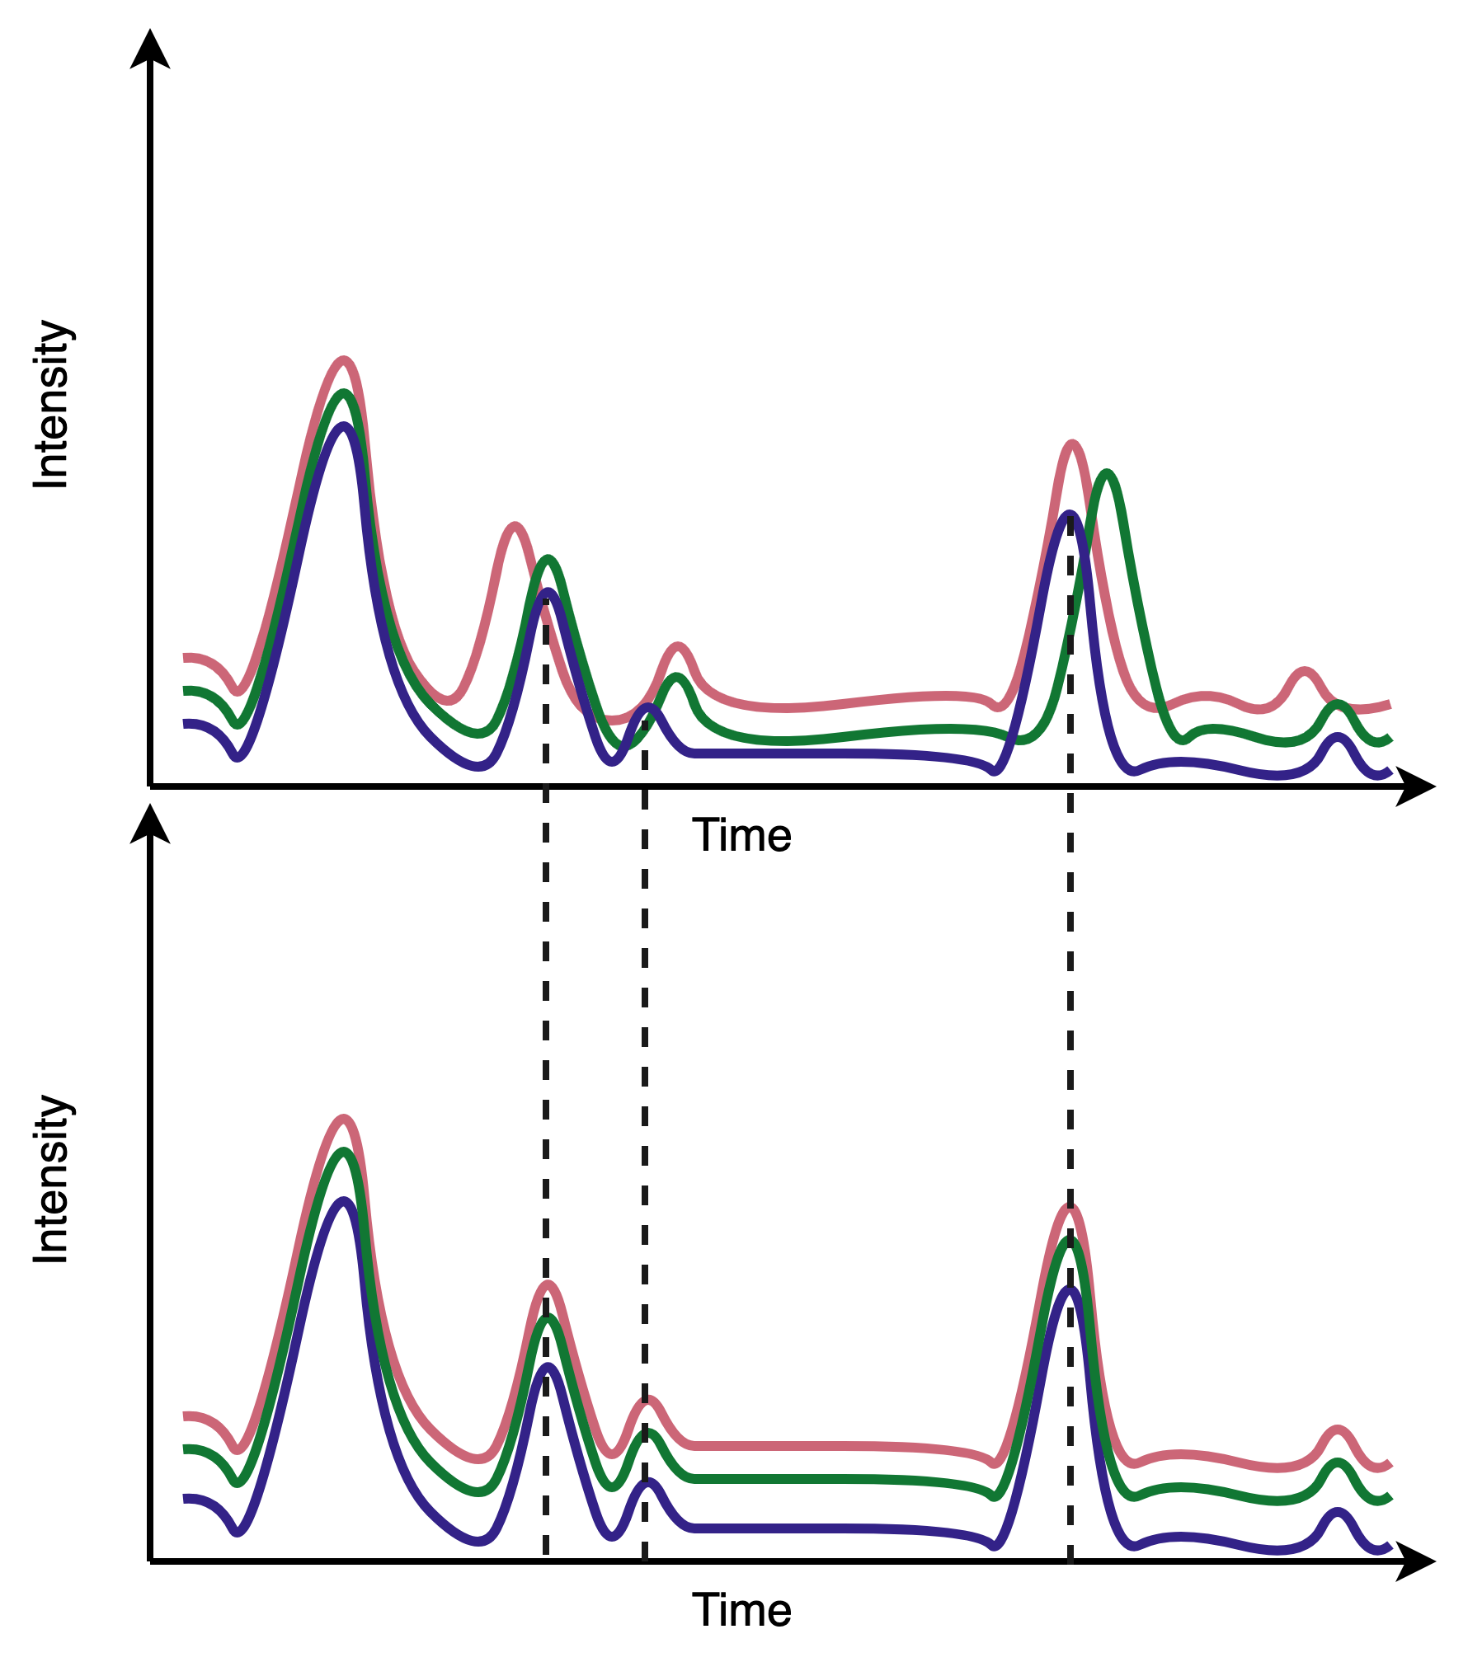
4. Map alignment
Performs a linear retention time alignment, to correct for linear shifts in retention time.
Notes:
Work with figure – reference for alignment is the file with the highest number of features (purple)

Slide 21
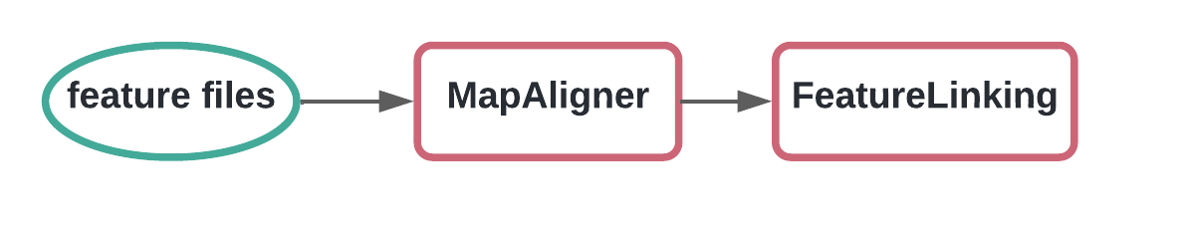
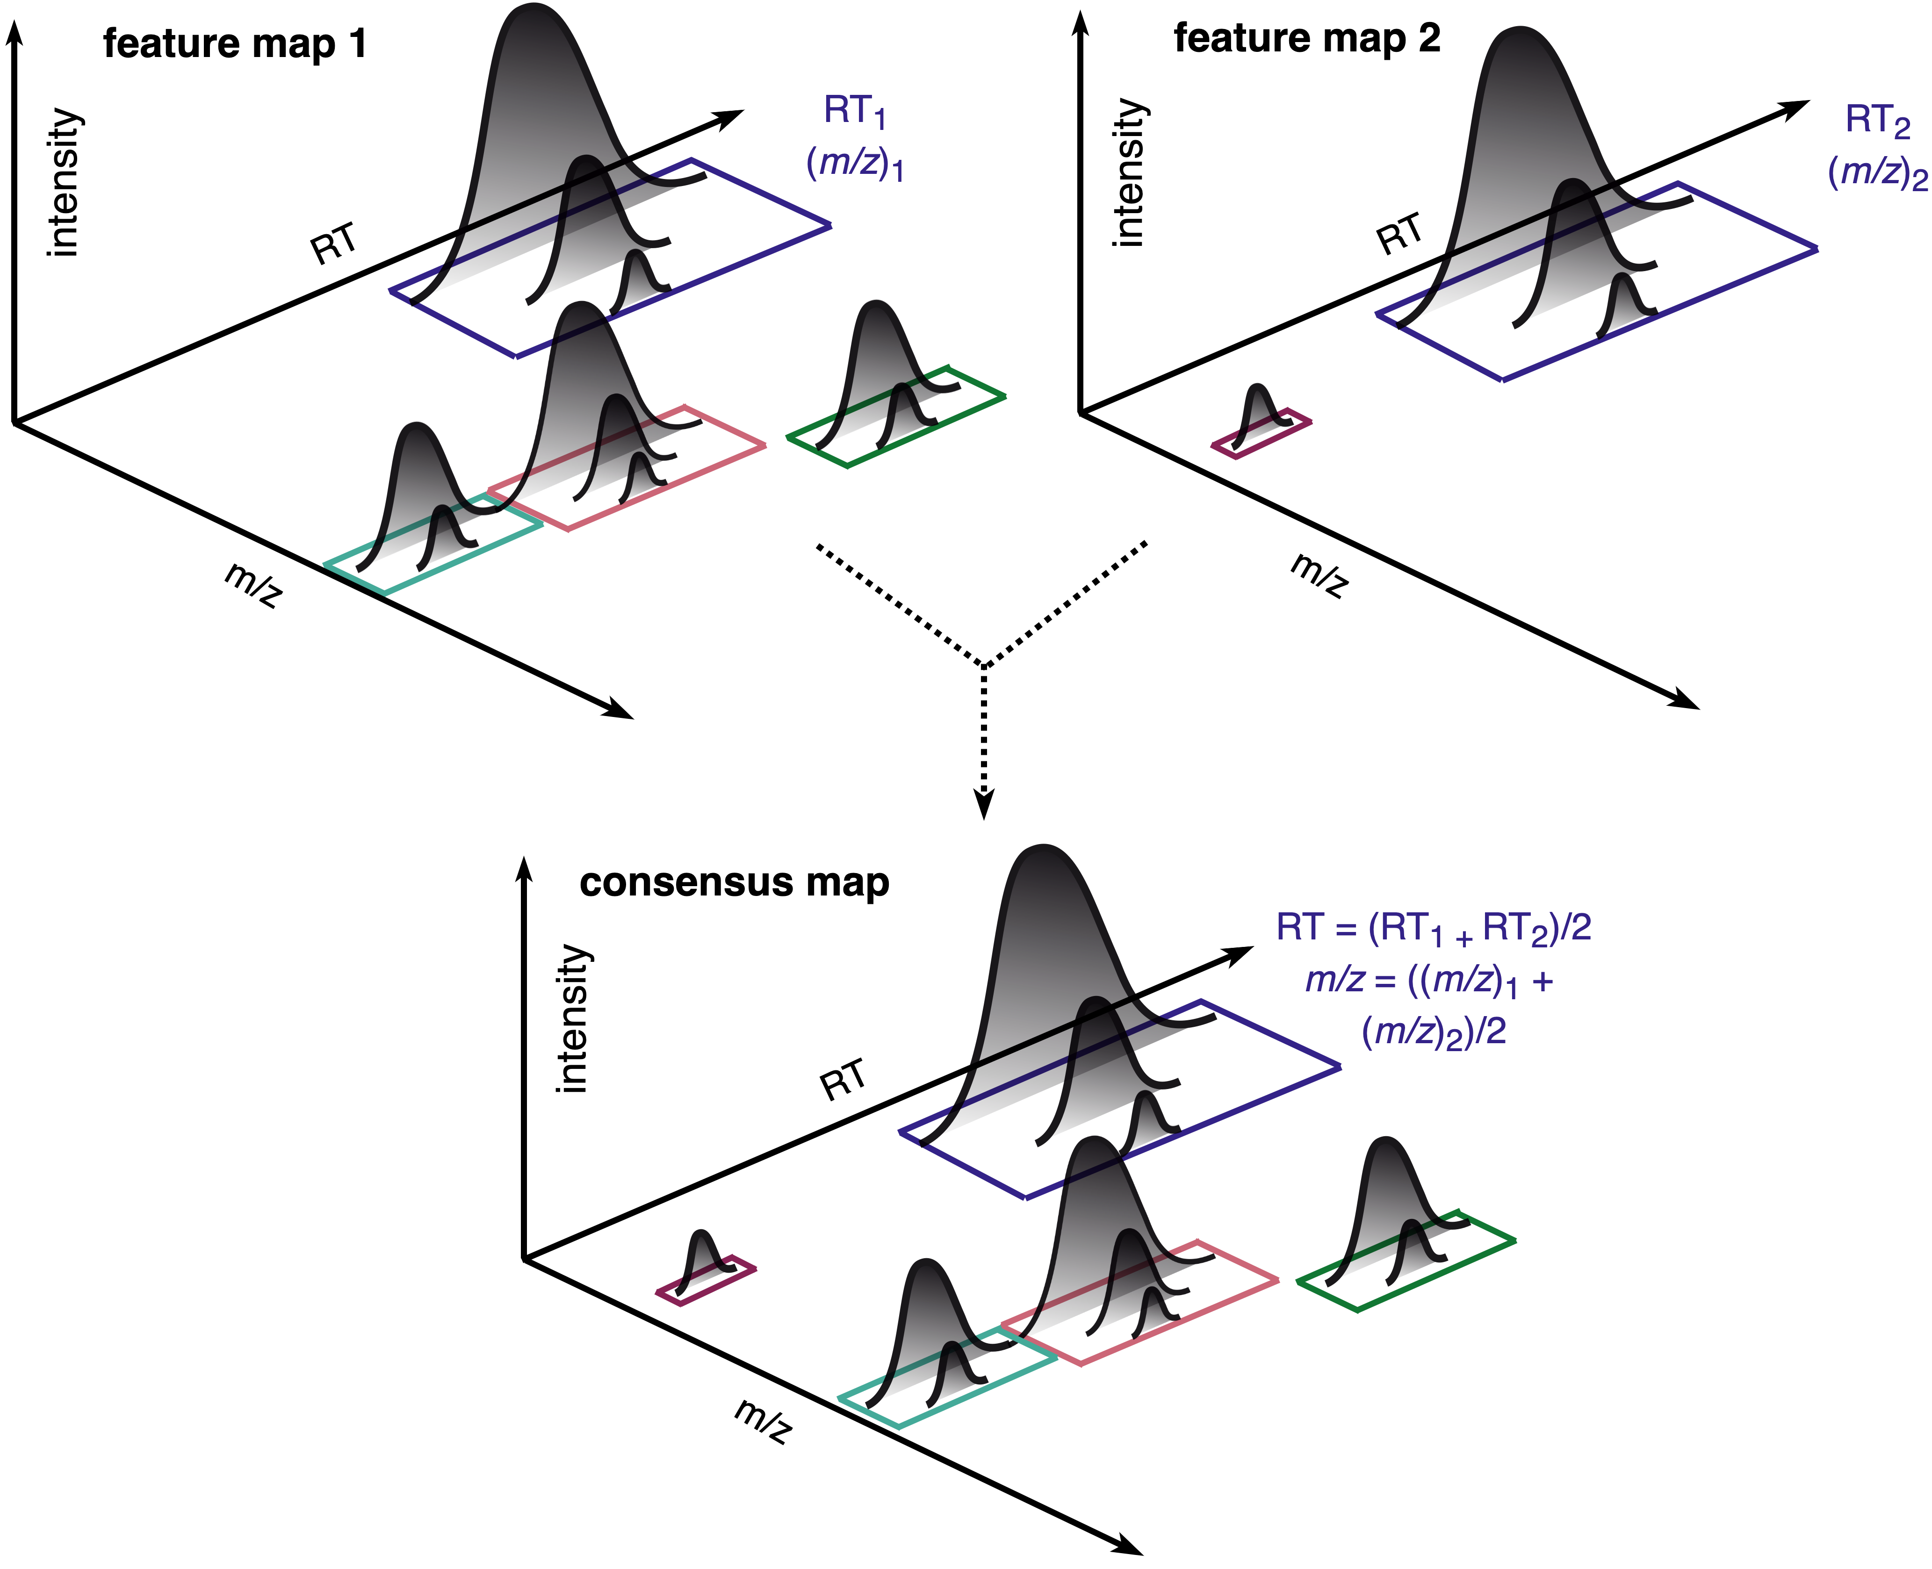
5. Feature linking
FeatureLinking clusters the feature information (from single files) into a ConsensusFeature, linking features from different files together, which have similar m/z and RT (MS1 level)
Notes:
We have two feature maps that have several features , different ones or the same..

Slide 22
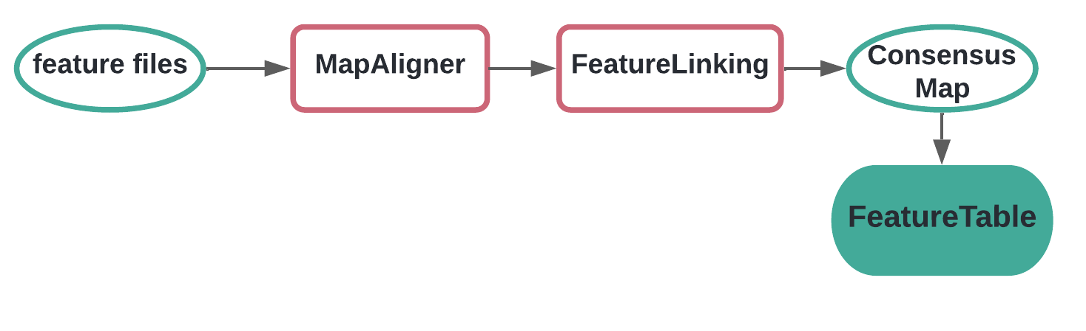
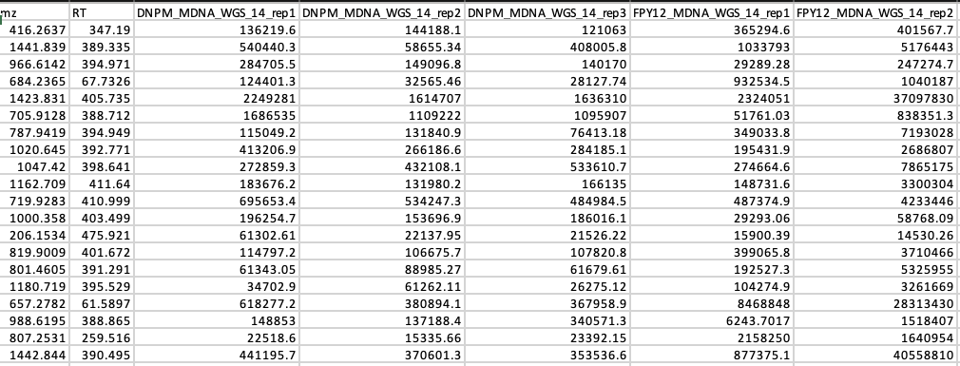
6. Table of features
Dataframe with m/z and RT information from each consensus feature with the intensities in each sample

Slide 23



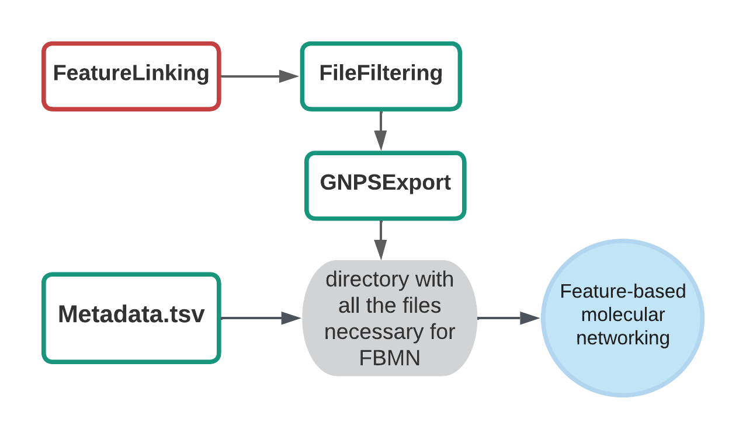
Suggestions after pre-processing
SiriusAdapter: Generate formula and structural predictions with SIRIUS and CSI:FingerID (MS1& MS2)
Adduct annotation: Assign adducts & reconstruct neutral masses
GNPSExport: Generate all the files necessary for Feature-Based Molecular Networking (FBMN) and
Ion Identity Molecular Networking (IIMN)
https://pyopenms.readthedocs.io/en/latest/index.html
Kai Dührkop, Markus Fleischauer, Marcus Ludwig, Alexander A. Aksenov, Alexey V. Melnik, Marvin Meusel, Pieter C. Dorrestein, Juho Rousu, and Sebastian Böcker, SIRIUS 4: Turning tandem mass spectra into metabolite structure information. Nature Methods 16, 299–302, 2019.
Mölder, F., Jablonski, K.P., Letcher, B., Hall, M.B., Tomkins-Tinch, C.H., Sochat, V., Forster, J., Lee, S., Twardziok, S.O., Kanitz, A., Wilm, A., Holtgrewe, M., Rahmann, S., Nahnsen, S., Köster, J., 2021. , Sustainable data analysis with Snakemake. F1000Res 10, 33.
Nothias, L.-F., Petras, D., Schmid, R. et al. Feature-based molecular networking in the GNPS analysis environment. Nat. Methods 17, 905–908 (2020).
Notes:
Build your own custom workflows for automated data processing

Slide 24
Hands-on time!
https://github.com/axelwalter/pyopenms-workshop
Click on the
24

Slide 25
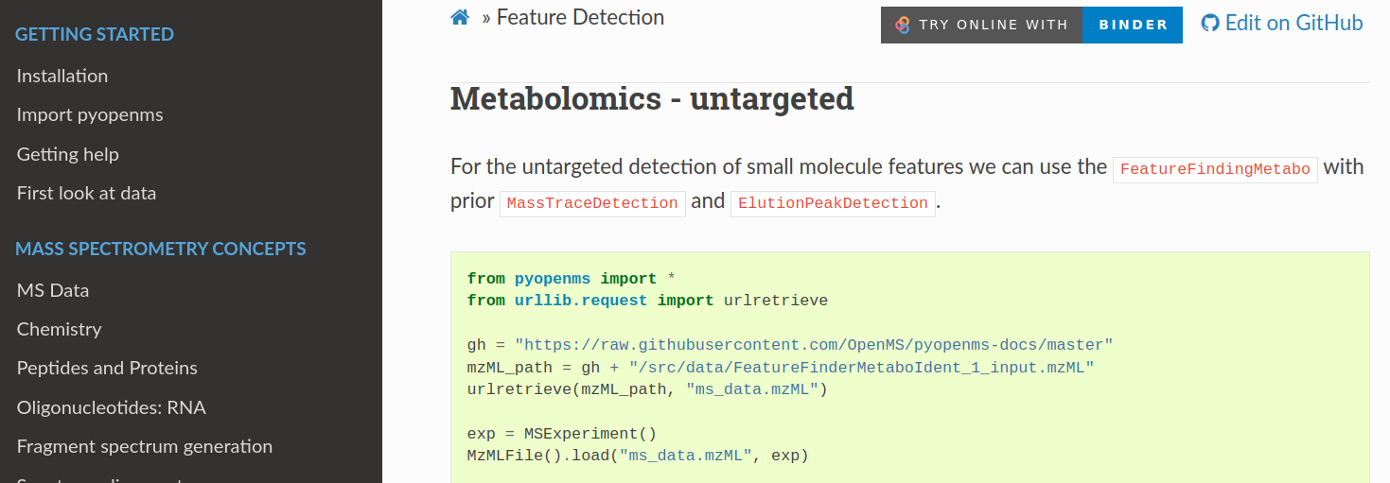
Visit our documentation:
https://pyopenms.readthedocs.io/en/latest/
25

